Slide 1
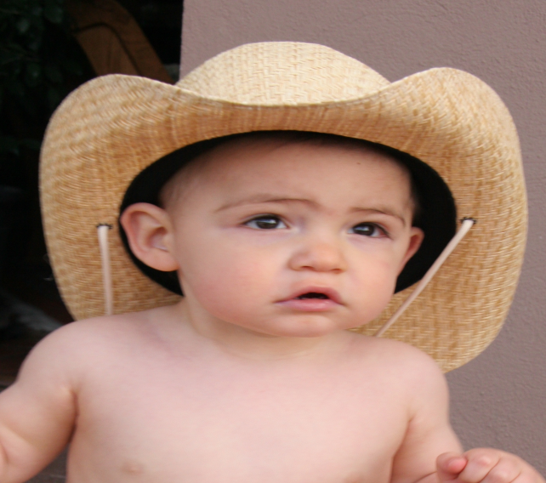

Cognitive Development
Jean Piaget believed infants begin at a cognitively “primitive” level and progress in distinct stages.
Piaget’s schemas are the most basic unit of intellect, which act as patterns that organize interactions with the environment.

Slide 2
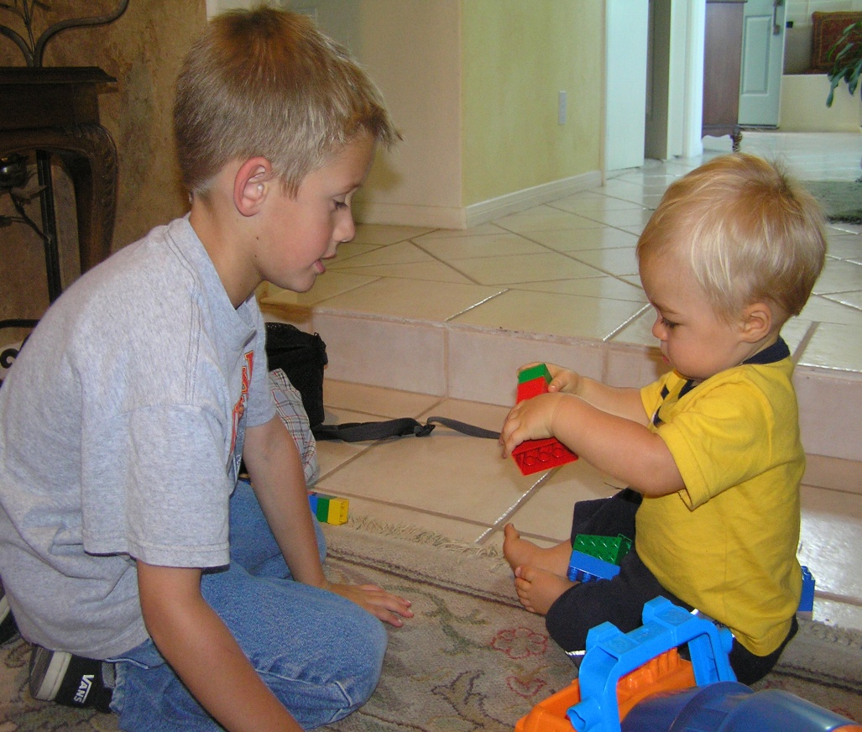
Cognitive Development (Continued)
Schemas grow and change due to:
Assimilation: absorbing new information into existing schemas
Accommodation: adjusting old schemas or developing new ones to better fit with new information

Slide 3
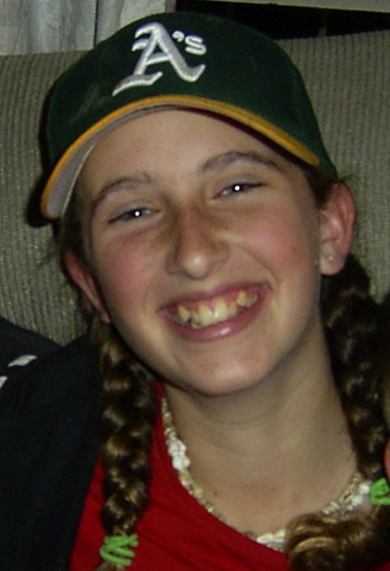
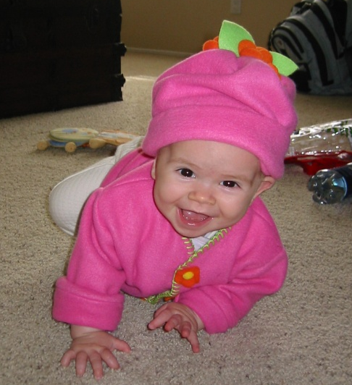


Cognitive Development— Piaget’s Four Stages
Sensorimotor: birth to 2 years
Preoperational: 2 to 7 years
Concrete Operational: 7 to 11 years
Formal Operational: 11 years and up

Slide 4
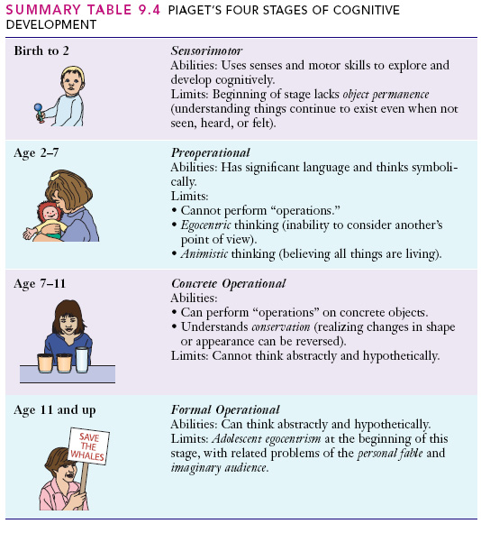
Piaget

Slide 5
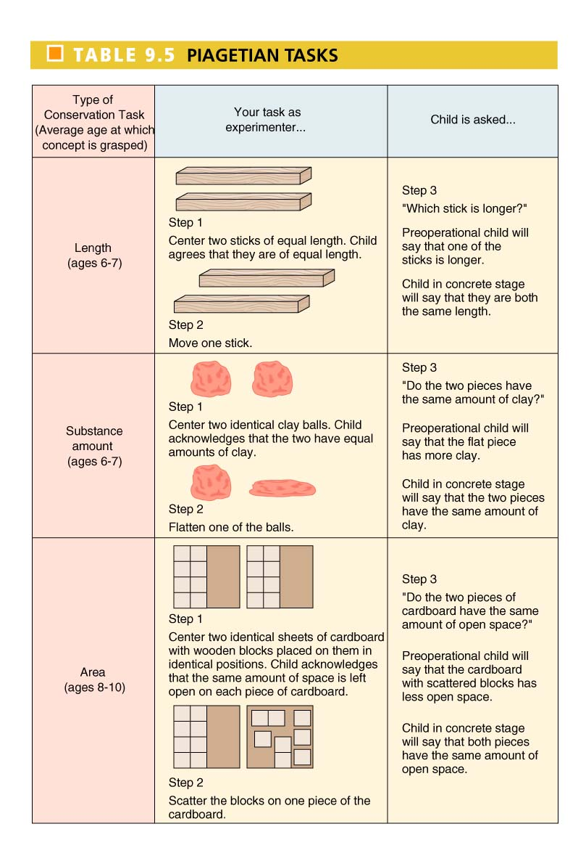


Slide 6
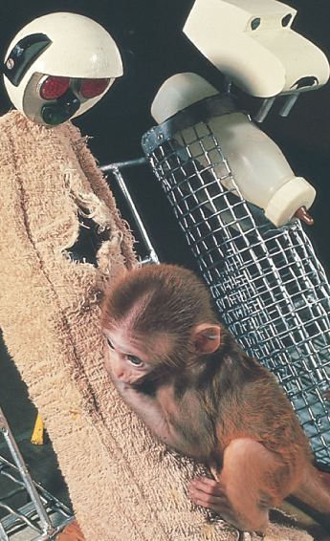
Social-Emotional Development
Social Development
Attachment: strong affectional bond with special others that endures over time
Harlow’s work with monkeys--feeding or contact comfort?

Slide 7
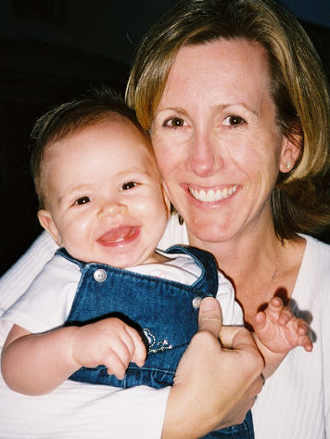
Social-Emotional Development—Three Levels of Attachment
Ainsworth’s strange situation procedure identified three types of attachment in children:
1. Securely Attached Child stays close to mother, shows moderate distress when separated, and is happy when mother returns.

Slide 8
Social-Emotional Development—Three Levels of Attachment (Continued)
2. Avoidant Child treats mother and stranger the same and rarely cries when mother leaves.
3. Anxious/Ambivalent Child is upset when mother leaves. When mother returns, child seeks closeness, but also squirms away.

Slide 9


Pause and Reflect: Why Study Psychology?
Research suggests the attachment patterns we develop as infants may carry over into similar patterns in our adult romantic relationships.

Slide 10

Social-Emotional Development—Baumrind’s Three Parenting Styles
1. Permissive
Permissive Indifferent Parents set few limits and give little attention or support.
Permissive Indulgent Parents are highly involved but set few demands or controls.

Slide 11
Social-Emotional Development—Baumrind’s Three Parenting Styles
2. Authoritarian Parents are rigid and punitive.
3. Authoritative Parents are tender and caring.
Study Tip: To avoid confusion, note:
Two “Rs” in AuthoRitaRian = “Rigid Ruler!”
Two “Ts” in AuThoriTarian = “Tender Teacher!”

